Slide 1

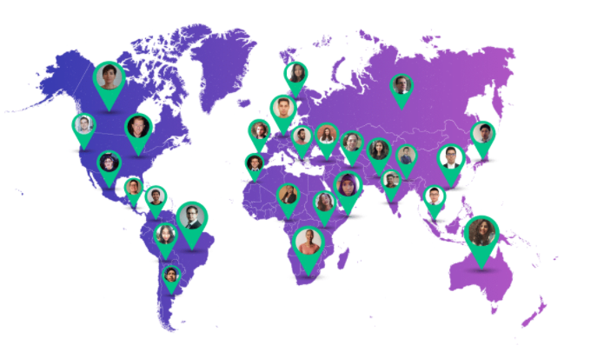
Date: 26/8/2021
Omdena is a global platform bridging mission-driven organizations with AI engineers, data scientists, and domain experts from diverse backgrounds to solve real-world problems. Omdena provides a streamlined collaborative environment to build innovative, ethical, and efficient AI and data science solutions.

Slide 2

Date: 26/8/2021
Omdena Lagos, Nigeria chapter is a part of Omdena that focuses on running open-source AI projects to solve challenges facing our local communities.

Slide 3
Date: 26/8/2021
Active collaborators
Opeyemi Adeniran: https://www.linkedin.com/in/opeyemi-taiwo-adeniran/
Edidong Esu : https://www.linkedin.com/in/edidiong-esu-1942a2129/
Ade-Onojobi Oluwadewalade: https://www.linkedin.com/in/dewalade/
Ismaila Lukman: https://www.linkedin.com/in/ismailukmanenegi/
Umar Fauwzziyyah: https://www.linkedin.com/in/fauzziyyah-ozohu-umar
Ajeyomi Adedoyin: https://www.linkedin.com/in/adedoyin-samuel-ajeyomi-83b80914b
Ayanlowo Babatunde: https://www.linkedin.com/in/ayanlola2002/
Egbigbe Osagie: https://www.linkedin.com/in/osagie-eboigbe-52b84794/
Ozeigbe Ojeifo: https://linkedin.com/in/ojeifo-oziegbe-516560146
Ayo Samuel: https://www.linkedin.com/in/sam-ayo
Nnaemeka Emmanuel: https://www.linkedin.com/in/emmanuel-nnaemeka-2b8378199/
Obembe David: https://www.linkedin.com/in/david-obembe-7b1636174
Kola-Adepoyigi Aderinsola: https://www.linkedin.com/in/aderinsola-pj-kola-adepoyigi-733510109/
Kenneth Imade : https://www.linkedin.com/in/kenneth-imade/
Areago Adedayo: https://www.linkedin.com/in/adedayo-areago-2a6a94183/
Emmanuel Salako: https://www.linkedin.com/in/adekunle-salako-59b6801b1/

Slide 4
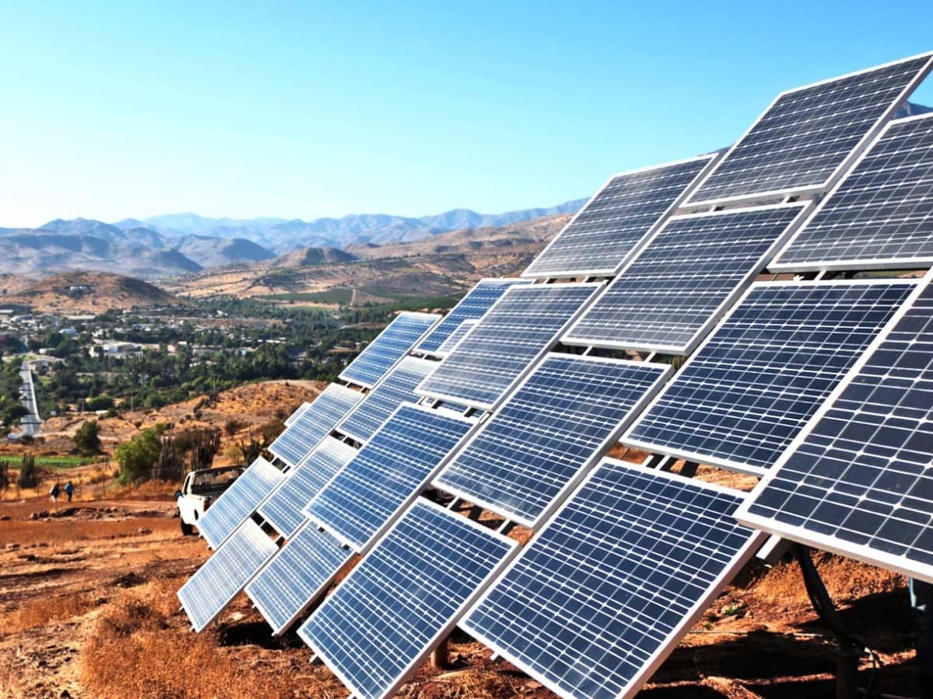
A.i for Renewable Energy
Date: 26/8/2021
Omdena Lagos, Nigeria Chapter
Presents

Slide 5


Date: 26/8/2021
Table of Contents
1.0 Introduction
2.0 Problem statement
3.0 Methodology
3.1 Data Extraction Implementation
3.1.1 Google Earth Engine
3.1.2 Data Extraction form GEE
3.2 Exploratory Data Analysis
3.2.1 Feature Engineering
3.2.2 Feature Selection and Scaling
3.3 Model Building
3.3.1 Model Evaluation
3.3.2 Clustering labelling
4.0 Result & Discussion
5.0 Conclusion
6.0 Recommendation
7.0 Appendix

Slide 6

Date: 26/8/2021
1.0 Introduction
Despite the fact that Nigeria is one of the largest africa oil producer and one of the best producing oil countries in the world. Currently, only 45% of Nigeria's population is connected to the energy grid whilst power supply difficulties are experienced around 85% of the time and almost nonexistent in certain regions.
The governments can dramatically reduce their carbon footprint by purchasing or directly generating electricity from clean, renewable sources and installing it to regions without power supply or not connected to the national electricity grid . The most commonly used renewable energy source is solar which will be our focus for this project

Slide 7

Date: 26/8/2021
2.0 Problem Statement
The Idea is to get the lists of top Nigerian regions with high demand for electricity and also to find the best spot for solar panel Installation.

Slide 8
Date: 26/8/2021
3.0 Methodology
Performed data modelling on the merged dataset using K-means clustering to classified and label the dataset as low, moderately low, medium intensity, moderate high intensity, high intensity
Get Population dataset
from WorldPop
Extract the average Nighttime light satellite images called VIIRS DNB from Google Earth Engine
Merge the mean value of VIIRS with Population dataset
Layer LGA shapefile on VIIRS dataset and extract the values using Zonal statistics to get the mean value of VIIRS in each LGA
Get the shapefiles of Local Government Areas in Nigeria
Energy Demand
DATE

Slide 9
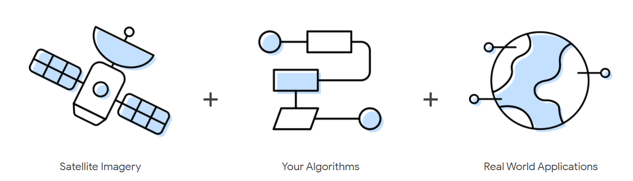
Date: 26/8/2021
3.1 Google Earth Engine (GEE)
Google Earth Engine combines a multi-petabyte catalog of satellite imagery and geospatial datasets with planetary-scale analysis capabilities and makes it available for scientists, researchers, and developers to detect changes, map trends, and quantify differences on the Earth's surface.
This is the platform that the task team used to collect night time images. It has a code editing platform where you can interact with it. More details: https://code.earthengine.google.com/
DATE

Slide 10
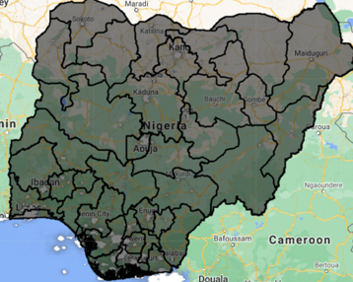
Date: 26/8/2021
3.1.1 Data Extraction from GEE
The code editor (as shown in the previous slide) is originally written in Javascript. Geemap is a Python package for interactive mapping with Google Earth Engine (GEE). It allows for access to GEE from your local directory. More details about geemap.
For this task, this was the main package used. More details of it being used in extracting the night time images in this task are in the night time task’s google collab notebook.
NIGHT TIME TASK DATA EXTRACTION WORKFLOW
Night time data set (VIIRS) from GEE
LGA | Lat | Long | Avg Night time mean
GEEMAP
Local Governmet Area (LGA) shapefile
DATE
Average night time mean for LGAs in Nigeria.

Slide 11
Date: 26/8/2021
3.1.2 Data Extraction Implementation
The night time task team extracted night time averages for the administrative regions in Nigeria. For the purpose of this project, we chose our regions to be the Local government areas in Nigeria (774 in total).
The dataset used for the night time is the VIIRS dataset (VIIRS Nighttime Day/Night Band Composites Version 1 is the name on Google Earth Engine). This contained the year range used in the project. This dataset is a composition of night time image collections covering the every year from 2012 -2021.
DATE

Slide 12
Date: 26/8/2021
A shapefile is a folder that contains administrative segmentations with its descriptions. For this task, the LGA shapefile was layered on the VIIRS data set and the values extracted using Zonal statistics.
A Zonal statistics operation is one that calculates statistics on cell values of a raster (a value raster) within the zones defined by another dataset (in this case LGAs shapefile). After layering the LGA shapefile on the VIIRS dataset, the mean value of each zone in the raster was calculated. The Geemap package has a class that helped hasten the process.
The population data of each LGA was extracted from World Pop Open Repository and merged with the average night time mean data. Data extracted was handed over to the data gathering team where they added more features to the data, preparing it to be modelled and Visualized.

Slide 13
Date: 26/8/2021
3.2 Exploratory Data Analysis
There were 774 LGAs in the country with 36 states the states having a minimum of 6 LGAs and a maximum of 44 LGAs
The LGA has an average land area of 1173. 07 square kilometer with 75% of the LGAs having a land area less than 1519.81 square kilometer.
The minimum and maximum land area coverage of the LGAs are 11.65 and 10357.67 square kilometer respectively.
Kano appears to be the most populated state with 13,724,250 residents, while Bayelsa is the least populated state having 1,099,952 residents.
Lagos state has the highest Average Nighttime light mean of 159.433944 as was expected while Bauchi state has the least Average Nighttime light mean of 0.052742.

Slide 14
Date: 26/8/2021
3.2.1 Feature Engineering
Feature Engineering is the process of using domain knowledge to extract features from raw data. From our data, we derived a new feature, population density.
Population density is the number of people living in a unit area per square kilometer. Mathematically, population density= Population/Area (km^2)
Reason
It is the most effective way to look at each LGA, its total occupants and land area. It eliminates any bias towards size of population or the land area of an LGA.

Slide 15
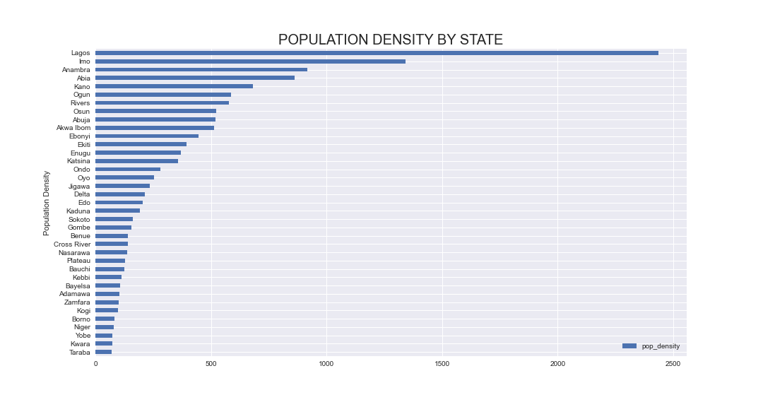
Date: 26/8/2021

Slide 16
Date: 26/8/2021
3.2.2 Feature Selection and Scaling
The two most significant feature used factored in the model are Population density and Average Nighttime mean. Using all features would require we perform feature encoding, this would increase the number of features in the data to be learnt by the model and would introduce complexities or clusters overlapping. Simplicity is better than Complexity.
Feature Scaling: This is a method used to normalize the range of independent variables or features of data.
The two features used in our model has a clear different range of values. This can cause the model (Kmeans) to be biased towards features having larger values (population density).
To avoid this, we had to scale the population density using StandardScaler estimator which transform each value as representation of the extent to which it deviates from the mean (0).
formula; z= x−μ/σ

Slide 17
Date: 26/8/2021
3.3 Model Building
The model used was Kmeans. It is a distance-based algorithm that tries to partition the dataset into K pre-defined distinct non-overlapping subgroups (clusters) where each data point belongs to only one group.
Prior to the instantiating the model and setting a pre-defined K clusters, an elbow plot was used to check for the optimal k clusters for the data the model was to learn from.
Although the optimal clusters for the data suggested by the elbow plot seems to fall around 11, we choose to settle for 5 clusters, the reason behind this was to avoid too many cluster as having too much clusters would mean resources would be pulled for several sections. This would require more labor and different procedures for the installation the solar panels at strategic positions.

Slide 18
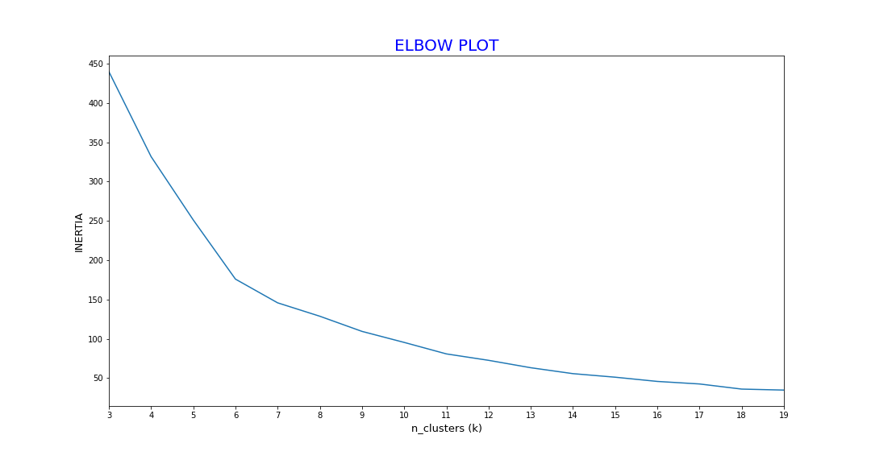
Date: 26/8/2021

Slide 19
Date: 26/8/2021
3.3.1 Model Evaluation
The evaluation metrics used was silhouette score. It is a metric used to calculate the goodness of a clustering technique and it ranges from -1 to 1.
When the value is 1, it means clusters are well apart from each other and clearly distinguished and when the value is 0, it means clusters are indifferent, or there is no significant difference between clusters. When it is -1, the clusters are wrongly assigned .
silℎouette score=(b−a)/max⁡(a,b)
The silhouette score of the model was 0.82 in 2d.p

Slide 20
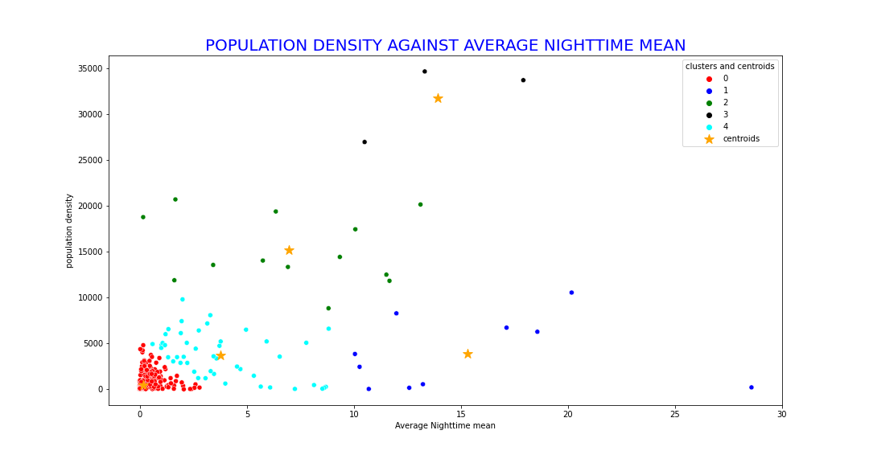
Date: 26/8/2021

Slide 21
Date: 26/8/2021
3.3.2 Clustering Labelling
The clusters generated by the model were renamed based on how much luminous intensity they emit.
From least luminous intensity to the most;
low intensity, moderately low intensity, medium intensity, moderate high intensity, high intensity.
During solar panel installation, LGAs that fall within low intensity cluster are placed as topmost priority while LGAs within the high intensity cluster are placed last.

Slide 22
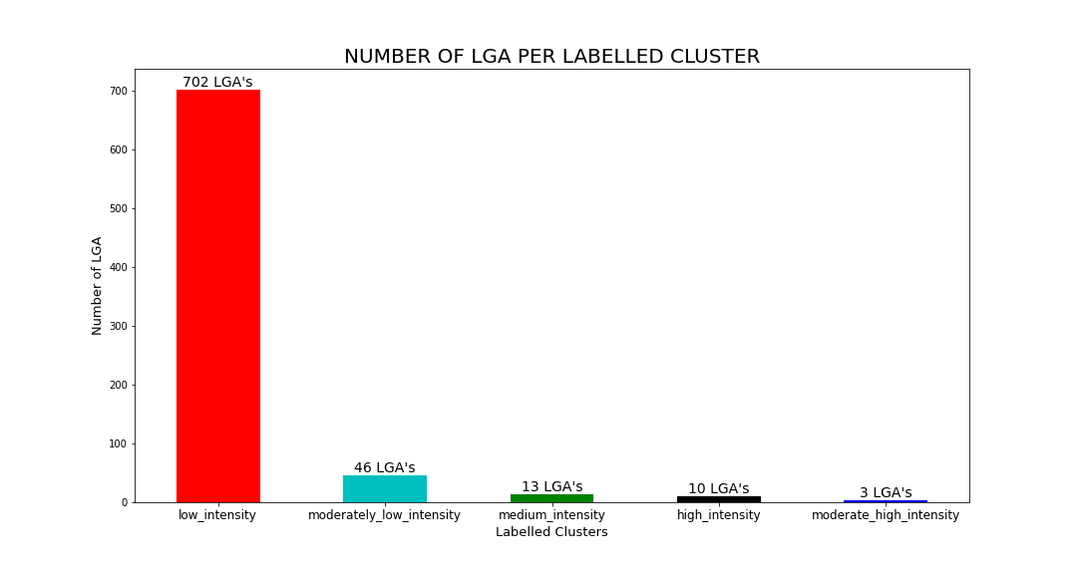
Date: 26/8/2021

Slide 23
Date: 26/8/2021
4.0 Result & Discussion
Kmeans clustering algorithm was used in modelling with a pre-defined clusters of 5.
Although, the elbow plot suggested an optimal clusters of 11, the chosen clusters was set so as to avoid too many clusters which would cause an increase in resources to be designated to those subgroups (clusters).
The model had a silhouette score of approximately 0.82 upon evaluation signifying clear and distinguished clusters.
The clusters were labelled from least luminous intensity to the most in the order; low intensity, moderately low intensity, medium intensity, moderate high intensity, high intensity. With low intensity being top on solar panel installation and high intensity coming last.

Slide 24
Date: 26/8/2021
The energy demand was visualized based on the 5 clusters gotten from the model along with their local governments areas to determine the best spot for solar panel Installation
How it works
We used Streamlit app to visualize the model
Steps to start using streamlit
Make sure that you have Python 3.6+ installed
Install Streamlit using PIP and run the "hello world" app
For further information on how to use this framework to build your own application please visit: https://docs.streamlit.io/en/stable/

Slide 25
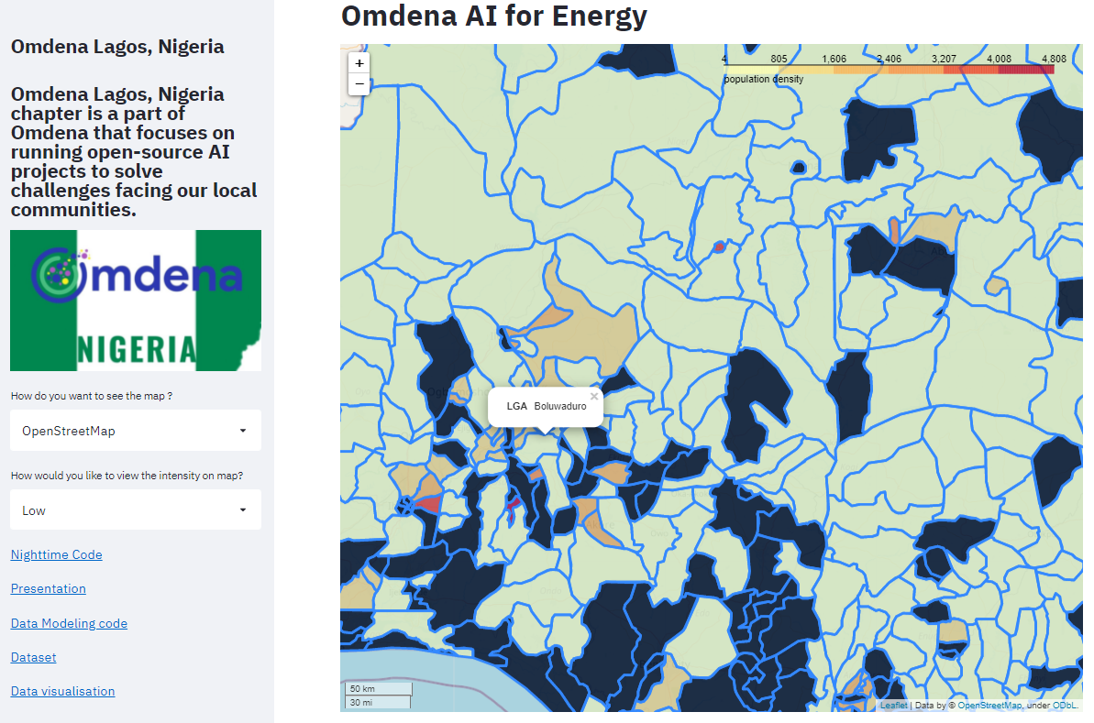
Date: 26/8/2021
Map Visualization of Population and Energy Intensity
Link to the streamlit App
https://share.streamlit.io/osabobo/omdena_app/app7.py

Slide 26
Date: 26/8/2021
5.0 Conclusion
The project over-all will help governments, NGOs and private sectors to survey and validate locations before installing solar panels to regions
The other aspect of the project may help government, NGOs and private sectors to dentify when to use renewable energy.

Slide 27
Date: 26/8/2021
6.0 Recommendation
Experimenting on more models with better performance metrics to validate such models

Slide 28
Date: 26/8/2021
6.0 Appendix
Raw data used
https://github.com/OmdenaAI/omdena-nigeria-energy/blob/main/src/final%20deliverables/Dataset_final/Nighttime_and_population_data.csv
Jupyter notebook for EDA
https://github.com/OmdenaAI/omdena-nigeria-energy/blob/main/src/final%20deliverables/task/Data_Modeling/Explainatory%20Data%20Analysis.ipynb
Jupyter notebook for data modelling
https://github.com/OmdenaAI/omdena-nigeria-energy/blob/main/src/final%20deliverables/task/Data_Modeling/Omdena%20cluster%20model.ipynb

Slide 29

Date: 26/8/2021

